Slide 1
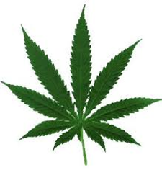
Mediating in Uncharted Waters: Medical Marijuana

Slide 2
Bill wohlsifer, Esq. attorney & mediator
Dispute Resolution Conference
Orlando
July 31, 2015
Tallahassee, Florida 850-219-8888
William@Wohlsifer.com

Slide 3
Marijuana
Dried mixture of leaves, flowers, stems, and seeds from the hemp plant, cannabis
Primary psychoactive ingredient is tetrahydrocannabinol (THC)
Cannabidiol (CBD) 1 of 60 compounds; medical benefits
Can be used to treat pain; lack of appetite; nausea associated with disease; cancer; medication; seizures; epilepsy; and many other conditions

Slide 4
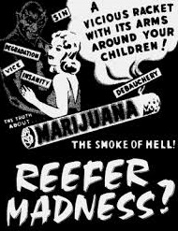
MARIJUANA v. cannabis
“Marijuana” is an anglicized term originating from “marihuana” in Mexican-Spanish
In the U.S. the plant and drug were more commonly known as “cannabis” and “hemp”
Use of the term Marijuana was popularized along with the term “reefer” to increase opposition for the drug and plant
Preference should be given the scientific genus name “Cannabis” over the pejorative marijuana
Psychoactive vs. euphoric
Getting high vs. calming the mind

Slide 5
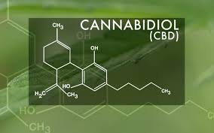
Medical Cannabis
Refers to the use of cannabis and its constituent cannabinoids, such as tetrahydrocannabinol (THC) and cannabidiol (CBD), as medical therapy to treat disease or alleviate symptoms.
Medical cannabis can be administered using a variety of methods, including vaporizing, or smoking dried buds, eating infused products, oral sprays, pills, topical creams, and tinctures

Slide 6
Important terms
“Qualified Patient”
“Medical Use”
“Cannabinoid Therapy”
“Whole Plant Therapy”
“Dispensing Organization”
“Compassionate Use Registry”
“Physician Ordering”
“Dispensing Region”
“Applicant” = “Nursery”

Slide 7
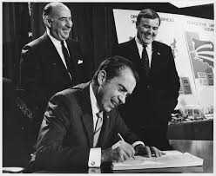
Uniform controlled substance act
Federal system
Mirrored by Florida
Five Schedules of regulation
Marijuana Schedule I
Cocaine Schedule II
Litigation
Taxation
Incarceration
Insurance
Banking
Loans
Research
DEA raids and intimidation

Slide 8
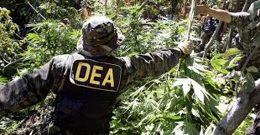
Federal response to state legalization
“Ogden Memo” (2009) DOJ should not focus on individuals in compliance with existing state MMJ
“Cole” Amendment (2011) Violation of fed money laundering and banking; (2013) While illegal under CSA, DOJ will only focus on “most significant threats”

Slide 9
Federal response to stateS (2015)
$1.1 trillion federal funding bill prohibits DOJ from using funds to go after state-legal cannabis programs, including Florida.

Slide 10
Florida: Introduction
The 2013, 2014 and 2015 Florida legislative sessions introduced numerous bills regarding:
Medical cannabis use
Public records of medical cannabis patients
Recreational marijuana use
Industrial hemp cultivation

Slide 11
Florida Cannabis Bills (2013 & 2014) Cathy Jordan Medical Cannabis Act
Rep. Edwards (2013); Rep. Saunders (2014); Sen. Clemens (2013-14)
A comprehensive farm bill
Homegrown with physician prescription
Possession of 250 grams of usable cannabis, 8 immature and 8 mature plants
Oils, topical, food products; paraphernalia; adults and minors
Probable cause or reasonable suspicion standing alone, not grounds for arrest
Contraband Forfeiture Act does not apply

Slide 12
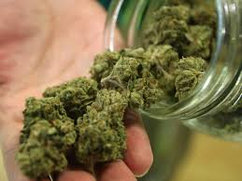
Federal Cannabis Bills (2015)
Representatives Jared Polis (D-CO) and Earl Blumenauer (D-OR) introduced two bills that together would legalize and tax marijuana at the federal level. Representative Polis’s legislation, H.R. 1013, the “Regulate Marijuana Like Alcohol Act” removes marijuana from the schedule set by the Controlled Substances Act; transitions marijuana oversight from the jurisdiction of the DEA to the ABTF&E.
Representative Blumenauer’s legislation, H.R. 1014, the “Marijuana Tax Revenue Act of 2015” creates a federal excise tax on non-medical marijuana sales to move this growing industry out of the shadows.

Slide 13
Florida Cannabis Bills (2015)
SB 528 - Brandes (R) (St. Petersburg): Medical Marijuana bill. Creates patient registry. All Agency oversight is vested in the DOH.
HB 683 - Steube (R) (Sarasota): Wood (R) Winter Haven): Medical Marijuana bill more restrictive than SB 528. Does not allow any form of smoking.
SB 1176 - Bullard (D) (Cutler Bay): Full recreational marijuana use bill for all persons age 21 and older; allows for homegrown and smoking.
HB 1297 - Bracy (D) (Ocoee): Recreational marijuana use bill and companion to SB 1176.

Slide 14
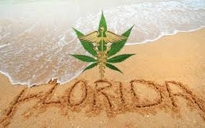
Florida Cannabis Bills (2015), contd.
HM 1179 - Gaetz (R) (Shalimar): Proposed memorial asking both chambers for a 60%
vote to send a message to Washington asking the president, the attorney general and both chambers of commerce to move cannabis
from Schedule 1 down to Schedule 2 of the federal Controlled Substances Act.
SPB 7066 - Brandes (R) (St. Petersburg): Glitch bill intended to improve the short comings of SB 1030 (approved by the 2014 legislature) now codified as ss. 381.986-7 (2014-15).

Slide 15
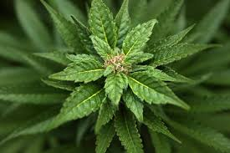
RECREATIONAL MARIJUANA
Substantially similar to FL liquor license law
Creates the ABM&T – licensed per capita
Excise tax of $50/oz., adjusted annually for inflation
Includes food products and food vendors
Age 21 and up
No medicinal use
City can ban cultivation facilities
Possession up to 2.5 oz. & 6 plants
Cannot endanger others (2nd Hand Smoke)
Mega land lease biz in proposed 566.03(d)(2), FS

Slide 16
“Charlotte’s web”
Ch. 2014-157
Laws of Florida
TITLE XXIX - PUBLIC HEALTH
CHAPTER 381
PUBLIC HEALTH: GENERAL PROVISIONS
Section 2. Section 381.986, Florida Statutes, is created to read:
381.986 Compassionate use of low-THC cannabis.
(a) “Dispensing organization” means an organization approved by the
department to cultivate, process, and dispense low-THC cannabis.

Slide 17
Florida’s cbd law
381.986 (Compassionate use of low-THC cannabis)
381.987 (Public records exemption)
385.211 (Epilepsy T & R at recognized medical centers)
893.02(3) (Criminal definition of cannabis)
1004.441 (Epilepsy post-secondary T & R education)
TITLE XXIX - PUBLIC HEALTH
FS 381.986(1)(b)
PUBLIC HEALTH: GENERAL PROVISIONS
‘“Low-THC cannabis’ means a plant of the genus Cannabis, the dried flowers of which contain 0.8 percent or less of tetrahydrocannabinol and more than 10 percent of cannabidiol weight for weight; the seeds thereof; the resin extracted from any part of such plant; or any compound, manufacture, salt, derivative, mixture, or preparation of such plant or its seeds or resin that is dispensed only from a dispensing organization.”

Slide 18
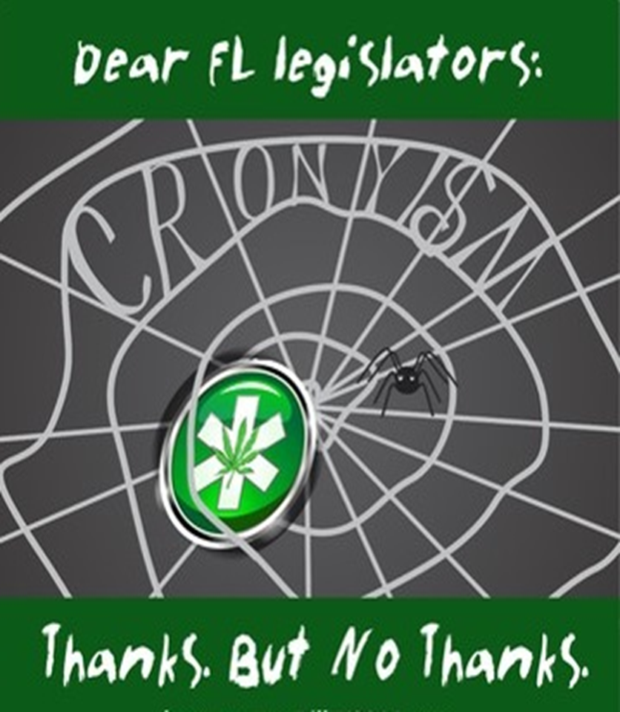

Slide 19
DOH Office of compassionate use rule making
Rules 64-4.001, .002, .004, .005 & .009
30 years; $60,063 app fee; score cards; Dept. of Ag > 400,000 plants; $5M performance bond; certified financial ability for 2-yr cycle
Promulgation triggered six DOAH administrative rule challenges – petitioners and the agency were ripe for mediation under s. 120.573
Nursery application period ended July 8, 2015
Vertical integration lawsuits and mediations likely to follow

Slide 20
Compassionate Use Registry
Ch. 2014-158
Laws of Florida
Legislative Findings, Sec 2
“The knowledge of a patient’s use of low-THC cannabis, the knowledge that a physician orders the use of low-THC cannabis, and the knowledge of the patient’s medical condition could be used to embarrass, humiliate, harass, or discriminate against the patient and the physician. This information could be used as a discriminatory tool by an employer who disapproves of the patient's use of low-THC cannabis or of the physician's ordering such use.”

Slide 21
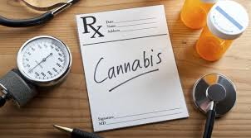
Compassionate Use Registry
Ch. 2014-158
Laws of Florida
Legislative Findings, Sec 2
“However, despite the potential hazards of collecting such information, maintaining the compassionate use registry established under s. 381.986, Florida Statutes, is necessary to prevent the diversion and nonmedical use of any low-THC cannabis as well as to aid and improve research done on the efficacy of low-THC cannabis.”

Slide 22
Florida Patient’s Bill of Rights – 381.026(4)(d)(3), FS
We Have Rights!
“A patient has the right to access any mode of treatment that is, in his or her own judgment and the judgment of his or her health care practitioner, in the best interests of the patient, including complementary or alternative health care treatments, in accordance with the provisions of s. 456.41.”

Slide 23
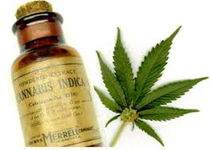
United for care/PUFMM – 2016 (68,315 Signatures to get Supreme court review; 683,149 to make ballot)
UFC’s 2014 ballot initiative obtained 57.62% of the 60% needed.
The new proposal specifies that parents would have to consent if their child is to receive MMJ.
Adds extra language to clarify that only people with “debilitating medical conditions” can medicate.
Clarifies that MMJ can only be recommended by a licensed medical physician.
DOH would empowered to deny felons “caregivers” status.
Clarifies that FL amendment does not immunize violations of federal law.

Slide 24
Mediation: Starting with the Seedlings
Potential New Disputes Ripe for Alternative Dispute Resolution:
Drug screenings of a “qualified patient” added to Florida’s compassionate use registry by a physician
Landlord who does not allow the tenant to use or possess cannabis despite the tenant’s lawful entitlement
Commercial lessor that prohibits the sale of marijuana products despite permissibility under local ordinances
The DOH issuance of a cultivation license is challenged by a competitor who was denied a license
Conflicting local and state ordinances affecting the marketing and sale of MMJ products
Termination of a patient’s enrollment in Florida’s compassionate use registry

Slide 25
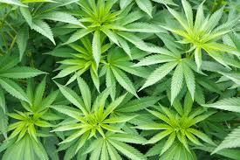
Agricultural Perspective – tax Exempt as AN ag Product? Statute 212.08(5)(A), FS
Is it a plant if sold to end- user as a farm product?
If sold to distributor exempt to producer?
Taxable to consumer for human consumption?

Slide 26
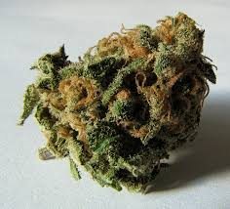
Tax Disputes
Exempt as an Ag. Product up to what point in conversion?
Is it a chemical compound? Medical device?
Is it a common household remedy? Over-the-counter drug?
Dietary supplement?
Nutritional supplement?
Rogaine vs. Nicorette?

Slide 27
Bill wohlsifer, Esq. attorney & mediator Copyright © 2015 William R. Wohlsifer, PA
www.infringement-attorney.com
Tallahassee, Florida
850-219-8888
William@Wohlsifer.com

